Slide 1
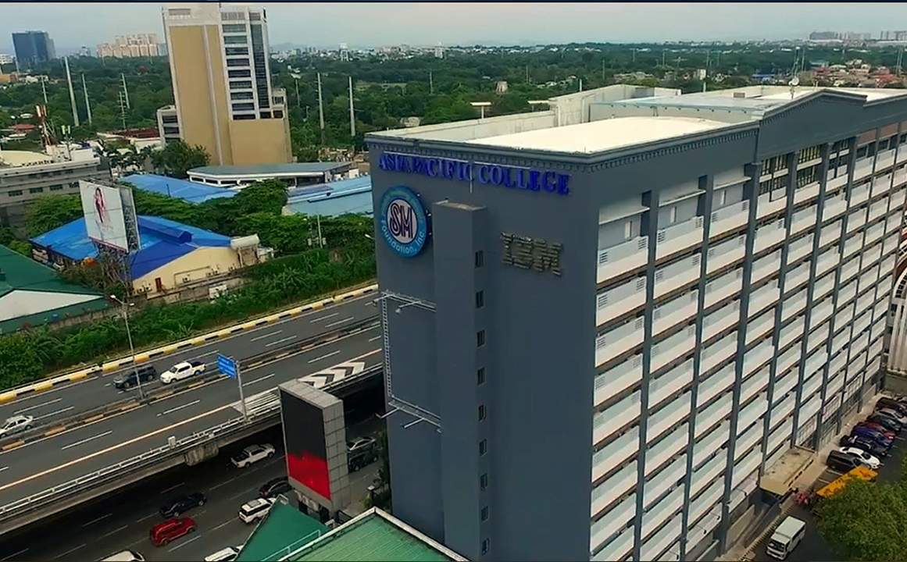

Project management plan
JUNE 5, 2023

Slide 2

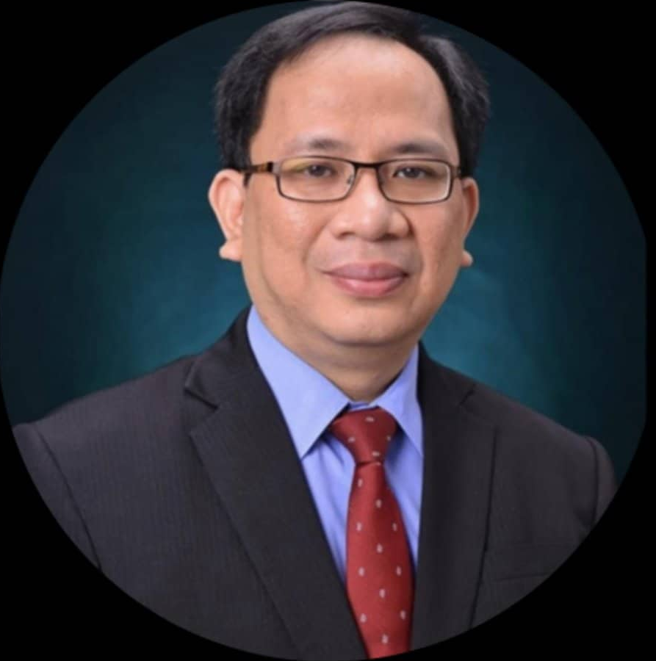


Introduction
Registered Name | Asia Pacific College – Information Technology and Resource Office
Company Logo (Tentative)
Address | 5th Floor, Asia Pacific College, 3 Humabon Place, Barangay Magallanes, Makati City, Metro Manila 1232
Telephone Numbers | N/A
Line of Business | Information Technology Assistance
Type of Customers | School Faculty and Students
Date of Registration | 1994
President | Jose F. Castillo
Number of Employees | 10
Presented by:

Slide 3
Problem statement
The Asia Pacific College ITRO Department lacks a dedicated ticketing system to help them address the school’s technical-related problems instead of using an email-based reporting system.
Presented by:

Slide 4
Project purpose/justification
Business Needs
Business Objectives
Presented by:

Slide 5
Project deliverables and milestones
RAMS Corner Ticketing System is a web-based application that would make use of a ticketing method like that of Discord and other outsourcing companies that would not only help the students and teachers get an equal chance to be given audience by the ITRO. Making troubleshooting easier and much more convenient.
Presented by:

Slide 6
Project deliverables and milestones
A single system for accessing all queries and reports, rather than needing to navigate two separate ITRO email accounts
a Knowledge Base feature for the solutions to the most common problems that can be addressed by the client themselves, thus, reducing the tickets received by the ITRO by at least 30 – 40%.
Presented by:

Slide 7
Project deliverables and milestones
Streamlined and tailor-made ticketing service system for the ITRO workflow.
Added features to automatically send a uniform and accurate ticket by three (3) to five (5) mouse clicks and drastically lower the time it takes for the client to send a query from five to ten minutes, down to 10-90 seconds.
Presented by:

Slide 8
Project deliverables and milestones
User manual, system requirement specification, and other necessary documentations will be provided to the ITRO to effectively use the new system.
A report detailing the benefits and cost savings achieved through the implementation of the RAMS Corner: Ticketing Service System
Presented by:

Slide 9
Project deliverables and milestones
Project Milestone | Target Completion Date
Project kick-off meeting | March 2022
Planning phase completion | March 2022
Analysis and Design phase | March 2022
Implementation phase completion | May 31, 2023
Testing and quality assurance phase completion | August 31, 2023
Deployment phase completion | September 15, 2023
Project close-out meeting | September 30, 2023
Presented by:

Slide 10
Stakeholder register
Name | Position | Internal, External | Project Role | Contact Information
Mir Tolentino | Manager of Operations | Internal | Project Sponsor | mir.tolentino@telusinternational.com
CREST Team | Team Members of Operations | Internal | Internal User of the system | CREST@telus.com
TELUS Technicians | Technicians, Customers | External | External user of the system | Cablerepair@telus.com
TELUS Managers | Managers, Customers | External | External user of the system | cnoemanagers@telus.com
Roselyn Angeles | Consultant | External | Project Manager | roselyn.angeles@telusinternational.com
Presented by: Khylle Tiquia

Slide 11
WBS
Dispatch Directory System 1
Initiation
1.1
Planning
1.2
Execution
1.3
Control
1.4
Closeout
1.5
Evaluation & Recommendations
1.1.1
Create Preliminary Scope Statement
1.2.1
Project Kickoff Meeting
1.3.1
Project Management
1.4.1
Document Lessons Learned
1.5.2
Develop Project Charter
1.1.2
Determine Project Team
1.2.2
Verify & Validate User Requirements
1.3.2
Project Status Meetings
1.4.2
Update Files/ Records
1.5.3
Deliverable: Submit Project Charter
1.1.3
Project Team Kickoff Meeting
1.2.3
Design System
1.3.3
Risk Management
1.4.3
Gain Formal Acceptance
1.5.4
Project Sponsor Reviews Project Charter
1.1.4
Develop Project Plan
1.2.4
Testing Phase
1.3.4
Update Project Management Plan
1.4.4
Archive Files/ Documents
1.5.5
Project Charter Signed/Approved
1.1.5
Submit Project Plan
1.2.5
Install Live System
1.3.5
Milestone: Project Plan Approved
1.2.6
User Training
1.3.6
Go Live
1.3.7
Presented by: Mohammad Darwish Mustary

Slide 12
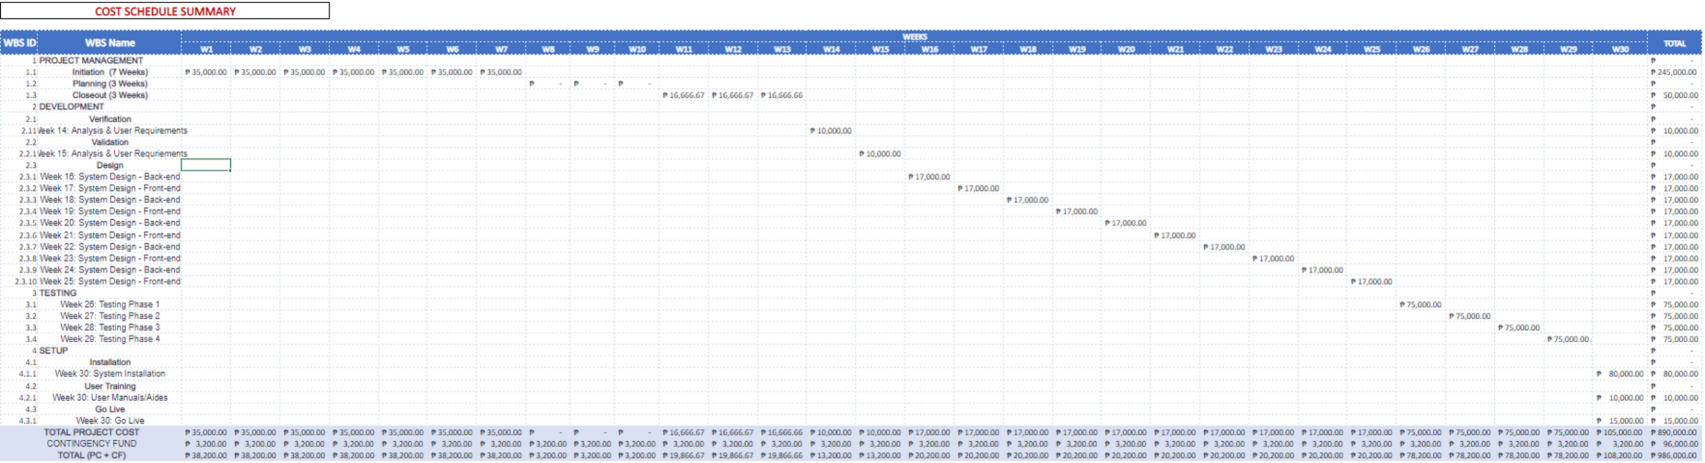
Cost schedule summary
Presented by: Jhon Karl Dumagpi

Slide 13
Schedule gantt chart summary
Presented by: Mohammad Darwish Mustary

Slide 14
Schedule gantt chart summary
Presented by: Mohammad Darwish Mustary

Slide 15
Schedule gantt chart summary
Presented by: Mohammad Darwish Mustary

Slide 16
change control board
Name | Position | CCB Role
Allan Vincent Nefalar | Frontend Developer | Project Manager
Ruth Morallos | Backend Developer | Scrum Master
Kieyl Ponce | UI/UX Designer | Product Owner
Vincent Nacor | Documentation Team | Project Team
Patrick Cortez | Documentation Team | Project Team
Bryan Geneta | Documentation Team | Project Team
Presented by: Jhon Karl Dumagpi

Slide 17
Communication matrix
Channel | Sender | Recepient | Type | Frequency | Format Used | Delivery media
Project Planning | Project Manager | Stakeholders | Meeting | Prior to commencing the project | Formal | Email, MS Teams, Google Meet
Release Planning | Project Manager, Project Team | Stakeholders | Meeting | Revisions will be made as needed before the initiation of the project. | Formal | Email, MS Teams, Google Meet
Sprint Planning | Project Manager | Project Team | Meeting | Once a week | Informal | Email, MS Teams, Google Meet
Management Processes | Project Manager, Project Team | Stakeholders | Artifact | The project will be reviewed and updated as necessary before it begins. | Document | Email, Google Spaces, Google Docs, Google Drive, Microsoft 365
Product Backlog | Project Manager | Project Team | Artifact | Once a week | Document | Google Docs, Google Spaces
Project Update | Project Manager | Project Team | Meeting | Once a week | Informal | Email, MS Teams, Google Meet
Presented by: Jhon Karl Dumagpi

Slide 18
Risk register
Risk ID | Risk Description | Risk Category | Risk Owner | Probability | Impact | Risk Score | Status | Target Resolution Date
RID 001 | Security Breaches - personal information can be compromised when there is weak security for the system. | Vulnerability in Security | Developer Team | 3 | 5 | 15 | Open | September 2023
RID 002 | System Downtime - inability to raise and resolve tickets in a timely manner | System Failure | Developer Team, Project Manager | 3 | 4 | 12 | Open | September 2023
RID 003 | Inadequate Scalability and Elasticity –unscalable or inelastic system will not be able to handle the increase or decrease in the volume of tickets received daily | System Failure | Project Manager | 3 | 5 | 15 | Open | September 2023
RID 004 | Lack of Integration –Inability to integrate means a decrease in productivity, that will therefore cause operational damage. | System Failure | Developer Team | 3 | 3 | 9 | Open | September 2023
RID 005 | Ticket Mishandling - human errors are a possible occurrence when handling tickets, this can be misrouting of tickets to unrelated staff/division/department or maybe failure in prioritizing of tickets. | Performance Issues | Project Manager | 4 | 3 | 12 | Open | September 2023
RID 006 | Poor User Experience – a very technical user interface is highly likely to overwhelm ordinary users, especially if they are non-IT people. | Performance Issues | Developer Team, Project Manager | 3 | 3 | 9 | Open | September 2023
Presented by: Khylle Tiquia

Slide 19

Transition approach
ITSupport@apc.edu.ph
itro@apc.edu.ph
RAMS Corner:
Ticketing Service System
Presented by: Jericho Aleta

Slide 20
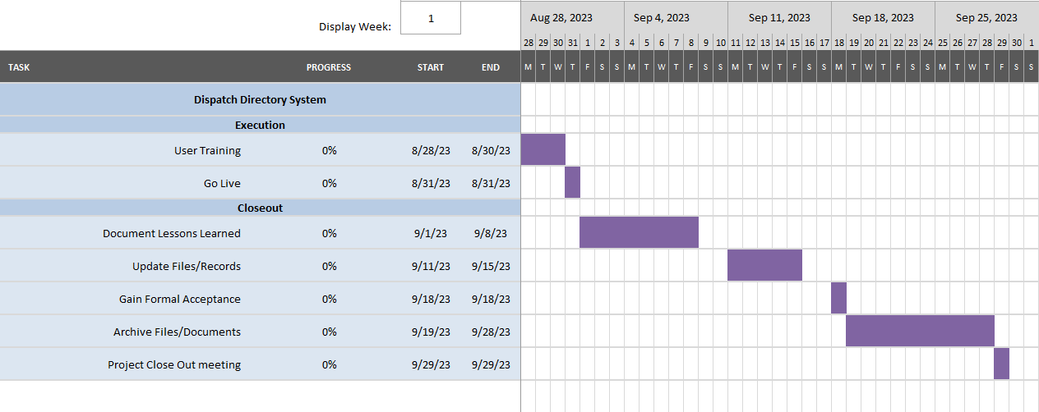
Transition out plan schedule
Presented by: Jericho Aleta

Slide 21

Questions?

Slide 22
Contribution/assignment
Name | Contribution/Assignment
Nefalar, Allan Vincent | Supervised the team and delegated tasks as the Project Manager Collaborated with the Scrum Master and Product Owner to ensure that the project is moving constantly while adhering to the stakeholders’ best interests. Contributed in OpenProject Gantt Chart Participated in Client Meetings Moderated some meetings with Project Adviser Added Company Profile, Project Charter, Stakeholder Management, Scope Management Plan, Cost Management Plan in WikiHub Maintained WikiHub and edited its general format for consistency. Created Stakeholder Analysis, Cost Management Plan, Communication Management Plan then created the initial Project Budget
Nacor, Vincent | Cooperated with the Project Manager as a part of the Documentation Team while adhering to the Documentation Manager’s guidelines Attended group and client meetings Created Schedule Management Plan Created Procurement Management Plan Added Schedule Management Plan and Procurement Management Plan in WikiHub
Presented by: Roselyn Joy Angeles

Slide 23
Contribution/assignment
Name | Contribution/Assignment
Ponce, Kieyl D. | Worked closely with Scrum Master and Project Manager as the Product Owner Contributed in OpenProject Gantt Chart Participated and moderated client and group meetings in the absence of the Project Manager Added Scope Management Plan, Business Case, and Quality Management Plan in WikiHub and revised budgeting plan for the project. Created Business Case, Scope Management, & Quality Management Plan Edited, revised and added missing contents for the Consolidated Project Management Plan. Edited and provided guidelines for the contents of the documents submitted by the Documentation Team as the Documentation Manager upon creation Created Group Presentation Deck
Geneta, Bryan | Cooperated with the Project Manager as a part of the Documentation Team while adhering to the Documentation Manager’s guidelines Attended group and client meetings Contributed in the creation of Work Packages.
Presented by: Roselyn Joy Angeles

Slide 24
Contribution/assignment
Name | Contribution/Assignment
Moralllos, Ruth | Spearheaded the team as the Scrum Master to make sure that the team adheres to the scrum methodology while overseeing the direction of the project and its development along with its documentation. Finalized the project’s budget and the WBS document
Cortez, Patrick | Cooperated with the Project Manager as a part of the Documentation Team Attended group and client meetings Created Stakeholder’s Management, Implementation Plan, and contributed in the creation of Work Packages. Added Risk Management Plan Implementation and HR Management Plan in WikiHub
Presented by: Roselyn Joy Angeles

Slide 25
Thank you!

